Slide 1
QSAR Biodegradation Dataset
Udit Choudhary

Slide 2
QSAR
Quantitative structure–activity relationship models (QSAR models) are regression or classification models used in the chemical and biological sciences and engineering.
In QSAR modeling, the predictors consist of physicochemical properties or theoretical molecular descriptors of chemicals; the QSAR response-variable could be a biological activity of the chemicals. QSAR models first summarize a supposed relationship between chemical structures and biological activity in a data-set of chemicals. Second, QSAR models predict the activities of new chemicals.

Slide 3
Description
The QSAR biodegradation dataset was built in the Milano Chemometrics and QSAR Research Group (UniversitÃ degli Studi Milano Bicocca, Milano, Italy). The research leading to these results has received funding from the European Communityâ Seventh Framework Programme [FP7/2007-2013] under Grant Agreement n. 238701 of Marie Curie ITN Environmental Chemoinformatics (ECO) project.
The data has been used to develop QSAR (Quantitative Structure Activity Relationships) models for the study of the relationships between chemical structure and biodegradation of molecules. Biodegradation experimental values of 1055 chemicals were collected from the webpage of the National Institute of Technology and Evaluation of Japan (NITE). Contains 356 readily and 699 not readily biodegradable molecules.

Slide 4
Attributes
SpMax_L: Leading eigenvalue from Laplace matrix
J_Dz(e): Balaban-like index from Barysz matrix weighted by Sanderson electronegativity
nHM: Number of heavy atoms
F01[N-N]: Frequency of N-N at topological distance 1
F04[C-N]: Frequency of C-N at topological distance 4
NssssC: Number of atoms of type ssssC
nCb-: Number of substituted benzene C(sp2)
C%: Percentage of C atoms
nCp: Number of terminal primary C(sp3)
nO: Number of oxygen atoms
F03[C-N]: Frequency of C-N at topological distance 3
SdssC: Sum of dssC E-states
HyWi_B(m): Hyper-Wiener-like index (log function) from Burden matrix weighted by mass
LOC: Lopping centric index
SM6_L: Spectral moment of order 6 from Laplace matrix
F03[C-O]: Frequency of C - O at topological distance 3
Me: Mean atomic Sanderson electronegativity
Mi: Mean first ionization potential
nN-N: Number of N hydrazines
nArNO2: Number of nitro groups (aromatic)
nCRX3: Number of CRX3

Slide 5
SpPosA_B(p): Normalized spectral positive sum from Burden matrix weighted by polarizability
nCIR: Number of circuits
B01[C-Br]: Presence/absence of C - Br at topological distance 1
B03[C-Cl]: Presence/absence of C - Cl at topological distance 3
N-073: Ar2NH / Ar3N / Ar2N-Al / R..N..R
SpMax_A: Leading eigenvalue from adjacency matrix (Lovasz-Pelikan index)
Psi_i_1d: Intrinsic state pseudoconnectivity index - type 1d
B04[C-Br]: Presence/absence of C - Br at topological distance 4
SdO: Sum of dO E-states
TI2_L: Second Mohar index from Laplace matrix
nCrt: Number of ring tertiary C(sp3)
C-026: R--CX--R
F02[C-N]: Frequency of C-N at topological distance 2
nHDon: Number of donor atoms for H-bonds
SpMax_B(m): Leading eigenvalue from Burden matrix weighted by mass
Psi_i_A: Intrinsic state pseudoconnectivity index - type S average
nN: Number of Nitrogen atoms
SM6_B(m): Spectral moment of order 6 from Burden matrix weighted by mass
nArCOOR: Number of esters (aromatic)
nX: Number of halogen atoms
Experimental Class: Readily biodegradable (RB) and not readily biodegradable (NRB)

Slide 6
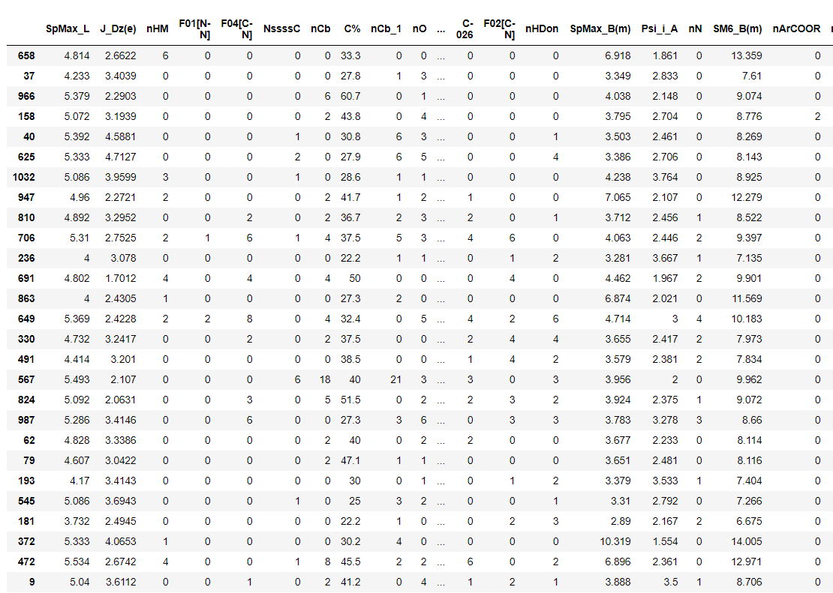

Slide 7
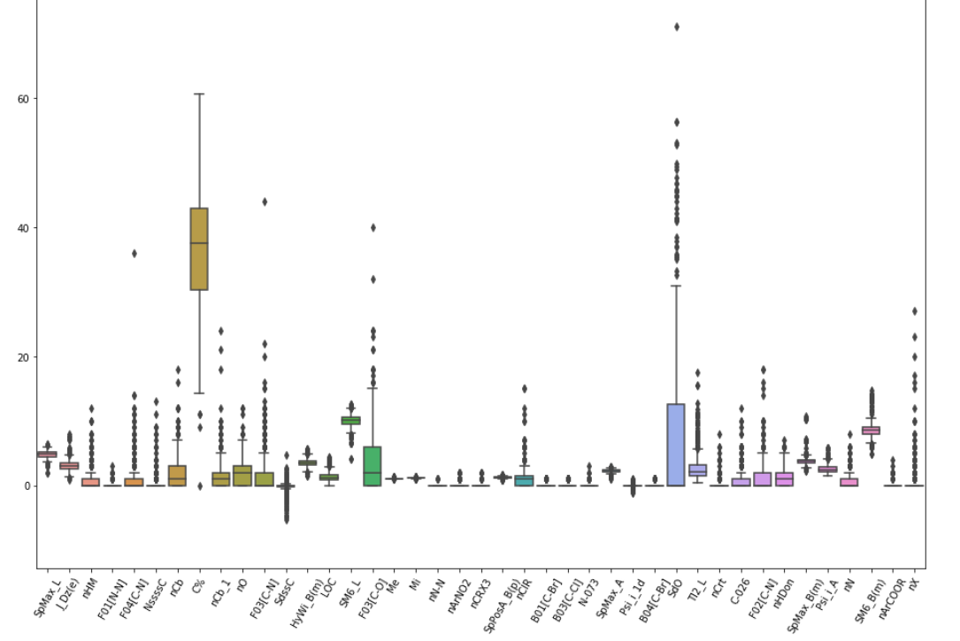

Slide 8
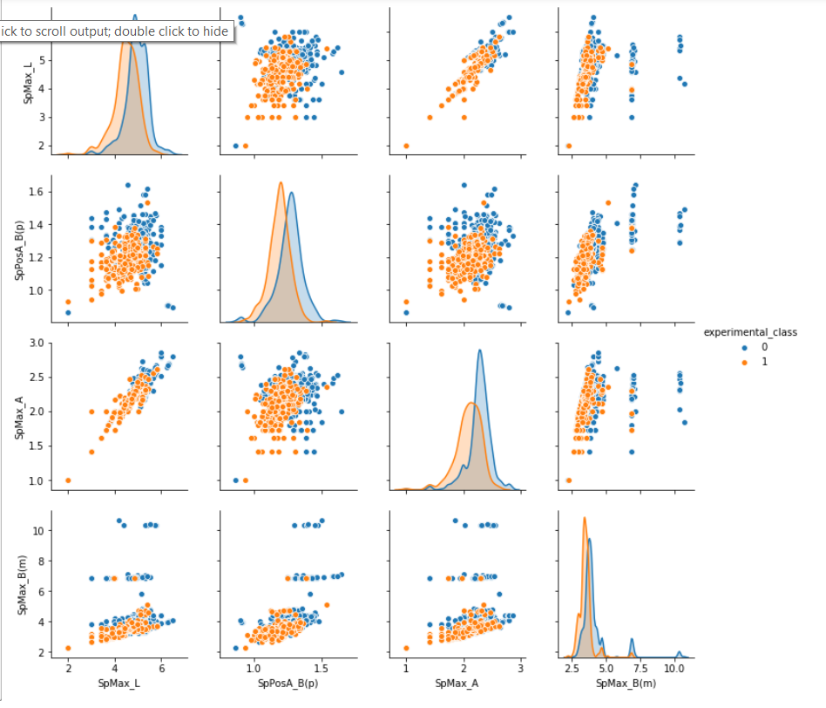

Slide 9
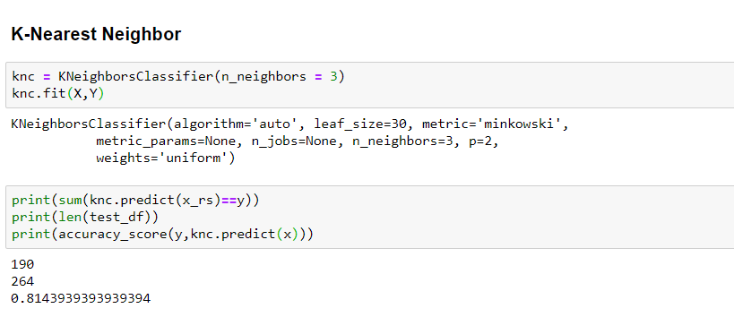
K-nearest neighbors (3 neighbors)

Slide 10
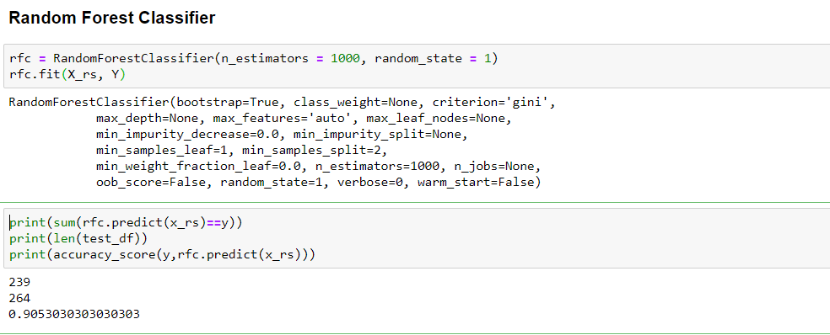
Random Forest Classifier

Slide 11
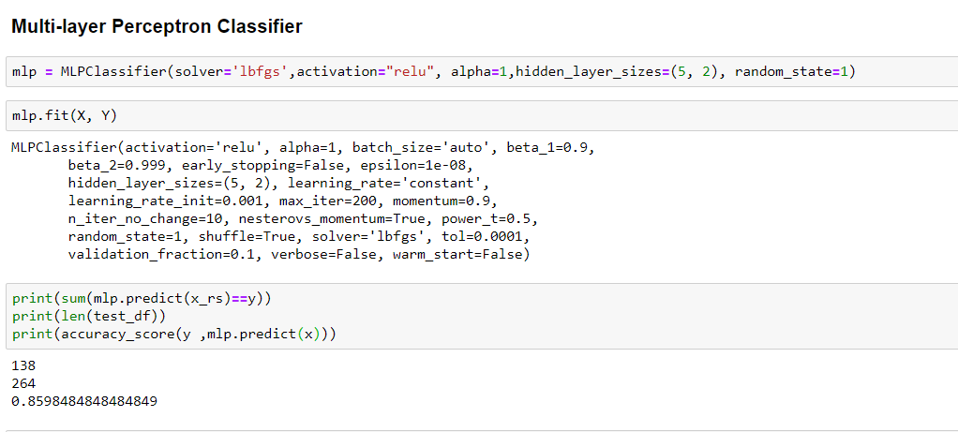
Multi-layer perceptron classifier

Slide 12
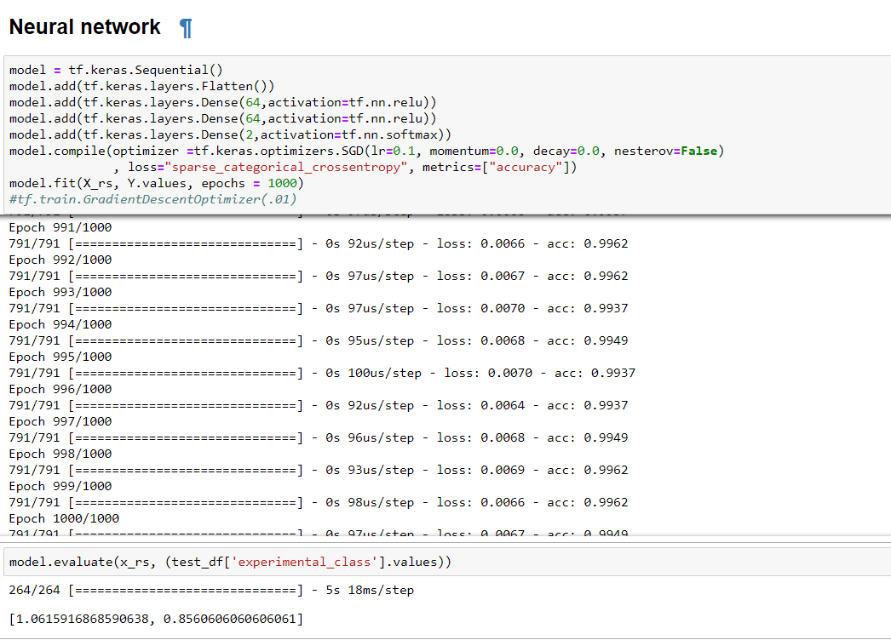

Slide 13
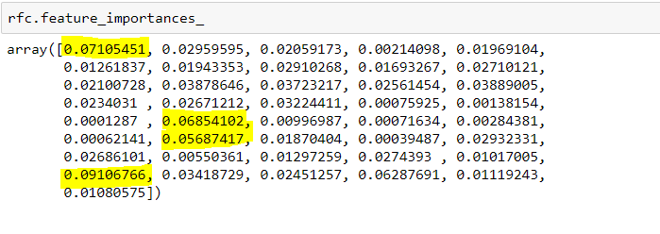
Feature importance
SpMax_L | SpPosA_B(p) | SpMax_A | SpMax_B(m)"

